Slide 1
HOW HOUSE RESOLUTION 1 IMPACTS RHODE ISLANDERS
Nina Harrison
Policy Director
November 4, 2025

Slide 2
Agenda
SNAP Changes
Medicaid and Medicare Changes
Healthsource RI and Expiring Enhanced Advanced Premium Tax Credits
Child Tax Credit Changes
Income Tax Provisions
Q&A

Slide 3
Supplemental Nutrition Assistance Program (SNAP)
SNAP serves 145,000 Rhode Islanders
91,000 households served in 2024
EPI is releasing data on SNAP use by state legislative district (using Census and USDA data compiled by CBPP) –
  Data reflects all state legislative districts – except 15 house districts where there was insufficient information to produce reliable data.

Slide 4
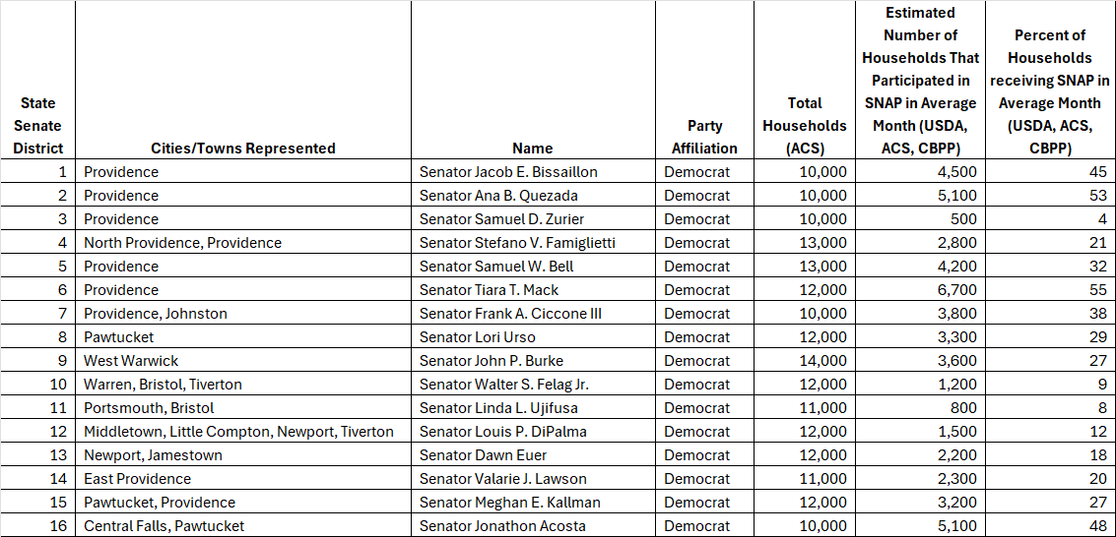
SNAP by State Legislative District

Slide 5
H.R. 1 SNAP Changes - Overview
10,000 Rhode Islanders are at risk of losing food assistance.
2,300 lawfully present immigrants will lose SNAP.
$15.2 million annual reduction in SNAP benefits for Rhode Islanders (due to eligibility changes).
Estimated total cost shift to state (administrative and benefit costs) - approximately $30 - $64.3 million per year.
SNAP Utility Allowance - 2,500 will lose or have reduced benefits.
Collateral consequences: less money in our state economy; less sales for grocers and small businesses; increased food insecurity and strain on RI Food Bank and direct service providers.

Slide 6
SNAP – Immigrant Eligibility Changes
•2,300 Rhode Islanders will lose benefits.
•A total of $5.5 million in benefits will be lost.
•No longer eligible: Refugees, humanitarian parolees, asylum grantees, abused spouses and children, and other non-citizens.
•Still eligible: Lawful permanent residents (Green Card holders), Cuban/Haitian entrants, and people from Micronesia, Palau, or the Marshall Islands living in the U.S.
•Implementation: pending federal guidance, these changes are likely to begin in early 2026.

Slide 7
SNAP - Work Requirements
9,300 Able-Bodied Adults Without Dependents (ABAWD) will now be subject to work requirements or no longer exempt.
No longer exempt from work requirements:
  Adults with children over 14 years of age
  Homeless individuals
  Veterans
  Those aged out of foster care and are under 24 years old
RI will no longer be eligible for city-wide exemptions for work requirements (with possible exception of New Shoreham).
Implementation – late 2025/early 2026
Collateral considerations: the state lacks capacity to facilitate compliance with work requirements; will lead to churn.

Slide 8
SNAP - Increased Costs to Rhode Island
H.R. 1 Administrative cost shift to states:
Currently: The federal government currently covers about 50% of SNAP administrative costs.
H.R. 1 change: Starting in FY 2027, the federal government's contribution will drop to 25% - RI will be responsible for the remaining 75% of administrative costs.
  This will cost RI an additional $12 - $13M per year.
Implementation: This cost share will begin in FY 2027.

Slide 9
SNAP – Error Rate
SNAP Benefits cost shift to states:
The federal government has historically covered 100% of SNAP benefit costs.
H.R. 1 change: States will now be required to pay a portion of benefit cost if the payment error rate exceeds 6%.
Rhode Islanders used $347 million in SNAP benefits in 2024.
Estimated cost for the state: $17.1 - $51.3 million/year (depending on error rate) beginning in FY 2028, based on payment error rates from either FY 2025 or FY 2026.
Error Rate Cost share structure:
  Error rates below 6% ------------------------------No cost share for benefits.
  Error rates between 6% and 8% ------------------Pay 5% of benefit costs.
  Error rates between 8% and 10% ----------------Pay 10% of benefit costs.
  States with error rates greater than 10% -------Pay 15% of benefit costs.

Slide 10
SNAP Utility Allowances (SUA)
EFFECTIVE 2025: H.R. 1 restricts eligibility for SUA shelter deduction to households with an elderly or disabled member.
2,500 households will lose or have reduced SUA.

Slide 11
H.R. 1 Healthcare Changes – Overview
Approximately 34,000 Rhode Islanders will lose healthcare due to H.R. 1.
Medicaid: Remove eligibility for many lawfully present immigrants; new work requirements, new cost sharing, and more frequent recertification req. for expansion group.
HealthSourceRI: 41,400 Rhode Islanders will lose $59.3M in federal subsidies – causing their premiums to double.
Medicare: Removes eligibility for some lawfully present immigrants beginning in 2027.

Slide 12
Medicaid in Rhode Island
311,000 Rhode Islanders rely on Medicaid
  164,000 children and families
  82,000 expansion group (100% - 138% FPL)
  11,000 children with special needs
  54,000 elderly, blind, and disabled folk

Slide 13
Medicaid - Immigrant Eligibility Changes
No longer eligible (effective October 1, 2026): Refugees, humanitarian parolees, asylum grantees, abused spouses and children, and other non-citizens.
Still eligible:
  US citizens or nationals, lawful permanent residents, Cuban/Haitian entrants, and people from Micronesia, Palau, or the Marshall Islands living in the U.S.
  All children up to the age of 19 (Cover all Kids) and pregnant and post-partum people will be eligible regardless of immigration status.

Slide 14
Medicaid Expansion Group – Eligibility Changes
82,000 Rhode Islanders are in the Medicaid expansion group.
New Work Requirements: for people between 100%-138% FPL (Medicaid expansion group).
Recertification: Every six months instead of annually.
Fewer Retroactive payments: Retroactive coverage offered for only one month instead of three.
Cost sharing: Now required to make co-pays and additional payments.

Slide 15
Medicare Eligibility Changes
No longer eligible (Beginning January 4, 2027): Refugees, humanitarian parolees, asylum grantees, abused spouses and children, and other non-citizens.
Still eligible: U.S. citizens or nationals, lawful permanent residents, Cuban/Haitian entrants, and people from Micronesia, Palau, or the Marshall Islands living in the U.S.

Slide 16
Healthsource RI (HSRI)
Rhode Islanders who are not eligible for Medicaid or Medicare and can't get coverage through an employer can purchase coverage through HSRI (esp. small business owners).
55,000 Rhode Islanders access commercial health insurance through HSRI.
7,000 Rhode Islanders will lose health insurance due to changes in HSRI eligibility requirements for immigrants.
A projected total of 20,000 Rhode Islanders will lose health coverage through HSRI due to H.R. 1.

Slide 17
HSRI & Expiring Enhanced Advanced Premium Tax Credits (APTCs)
(APTCs) are a temporary expansion of the Affordable Care Act subsidies that made healthcare more affordable for millions.
  90% of HSRI enrollees have their health insurance subsidized by federal tax credits.
H.R. 1 allows APTCs to expire at the end of 2025.
41,400 Rhode Islanders will see their premiums double (on average) without APTCs.
13,000 Rhode Islanders are predicted to not purchase health insurance because of APTCs expiring.

Slide 18
Child Tax Credit Changes
H.R. 1 increases the CTC from $2,000 to $2,200 per child BUT leaves the lowest-income Rhode Islanders behind.
42,000 children in Rhode Island will not receive the full tax credit because their parents don’t earn enough.
  Black and Latino children will be disproportionately harmed.
4,000 RI children won’t benefit from the credit at all because H.R. 1 requires U.S. citizen children and those with lawful status to have at least one parent with a Social Security number to qualify for the CTC.

Slide 19
Collateral Considerations
Increased healthcare costs and emergency room wait times for all, as people lose coverage and leave the insurance pool.
Increased food insecurity will worsen health and educational outcomes.
Attacks on immigrant communities increase inequity in RI and will harm our communities and workforce.
Some families will be affected by multiple aspects of H.R. 1 and face compound harm.
Many Rhode Islanders are already struggling to meet basic needs.

Slide 20
EPI Recommendations
Invest in Rhode Islanders:
Rhode Island must raise sufficient revenue to invest Rhode Islanders on the systems upon which they rely.
Invest in food security to replace lost food assistance.
Invest in healthcare to fund alternate means for Rhode Islanders to access life-saving care.

Slide 21
Alan Krinsky, Director of Research and Fiscal Policy
Income Tax Provisions
Small Business Stock Gain Exclusion
EPI Recommendations on Income Tax Provisions

Slide 22
Income Tax Provisions
What is Rolling Conformity?
What are Coupling and Decoupling?
Enacted FY2026 State Budget instructed Taxation Division to decouple from any new federal tax provisions made effective for Tax Year 2025 or earlier.
  H.R. 1 included 29 such tax provisions, 10 of which with possible impact on RI state revenue.
  Taxation issued emergency regulations to decouple, saving an estimated $80M in state revenue.

Slide 23
Income Tax Provisions
For Tax Year 2026 and beyond, further action will be required to keep RI decoupled from provisions that could cost revenue without benefiting the state:
      $34.7M in FY2026
      $36.4M in FY2027
Also provides an opportunity to decouple from some related provisions already in place.
This action can be taken by legislators and included in the Enacted FY2027 State Budget.

Slide 24
Small Business Stock Gain Exclusion
Excludes most of what we think of as small mom & pop businesses, as beneficiaries must be C-Corps.
Tax benefit made on companies in other states, so does not incentivize business activity in RI.
94% of benefit from existing exclusion goes to households with income over $1M.
If we do not decouple from expansion, additional $2.3M-$3.0M annual revenue loss by FY2031.
If we decouple from base credit, will prevent current and ongoing $3.7M annual revenue loss.

Slide 25
EPI Recommendations on Income Tax Provisions
Preserve 5-year amortization of R&D expenses
Preserve tighter TCJA cap on the deductibility of business interest
Preserve pre-OBBBA limits on small business expensing
Decouple from the Foreign-Derived Deduction Eligible Income deduction (the TCJA “FDII” giveaway)
Repeal RI’s conformity with OZ capital gains breaks
Repeal the QSBS capital gains break altogether, or at least decouple from the expansion

Slide 26
References
Center on Budget and Policy Priorities – Policymakers Should Expand the Child Tax Credit for the 17 Million Children Currently Left Out of the Full Credit
Center on Budget and Policy Priorities – Harmful Republican Megabill Fails Rhode Island Families, Children and Communities
Rhode Island Executive Office of Health and Human Services (EOHHS) Workgroup Presentation on Medicaid/Medicare
Rhode Island Executive Office of Health and Human Services (EOHHS) Workgroup Presentation on SNAP
Rhode Island Executive Office of Health and Human Services (EOHHS) Workgroup Presentation on Healthsource RI

Slide 27

Stay connected with EPI!
Like us on Facebook: facebook.com/economicprogressri
Follow us on X/Twitter: @EconProgressRI
Follow us on Instagram: @epi_ri
Sign up for our e-newsletter:

