Slide 1
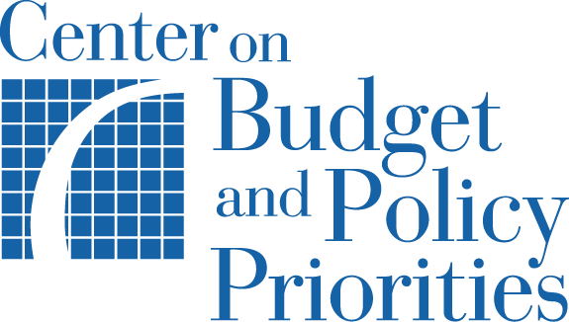
Understanding the 2025 Reconciliation Bill – H.R. 1
Nick Gwyn
Senior Fellow, Government Affairs, CBPP
November 4, 2025

Slide 2
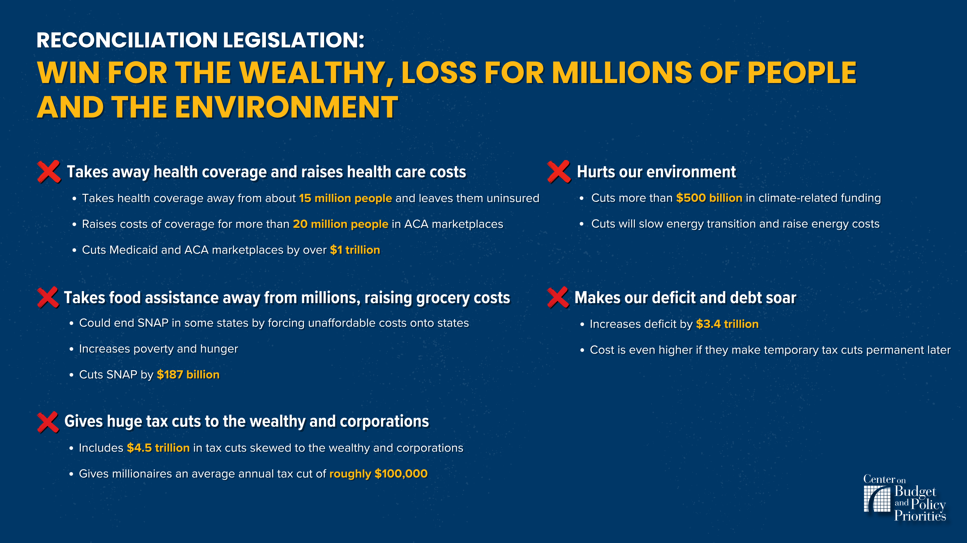
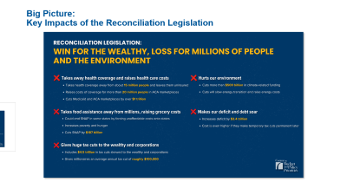
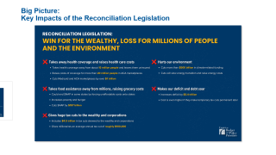
Big Picture: Key Impacts of the Reconciliation Legislation

Slide 3
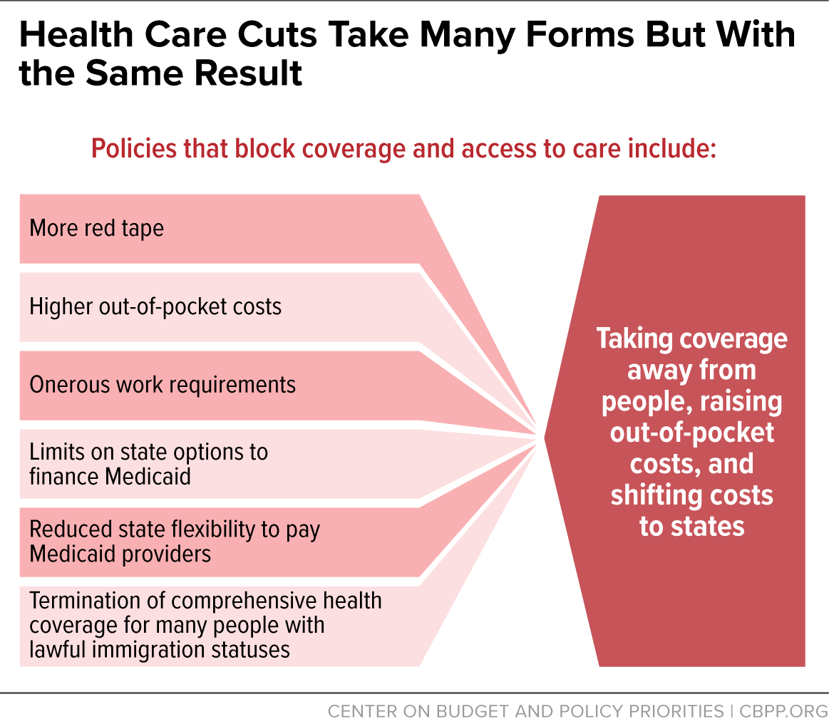
Largest Health Care Cuts in History
An estimated 15 million people will lose health coverage and become uninsured.
Creates vast new red tape in Medicaid including harsh work requirements and more frequent eligibility renewals
Strips access to Medicaid and CHIP coverage and ACA marketplace premium tax credits from many lawfully present immigrants
Increases cost-sharing for some in Medicaid expansion
Sharply restricts states’ ability to finance Medicaid
Raises costs of coverage for more than 22 million people in the ACA marketplace by failing to continue the enhanced premium tax credits
Makes it harder to access and retain marketplace coverage
Notes:
Now taken together, the cuts to health coverage in the Republican reconciliation bill come in many different forms, but they all lead to the same place:
Huge reductions in coverage for low- to moderate-income people, and additional costs that states and localities will have to shoulder. CBPP estimates more than 34,000 Rhode Islanders will lose health insurance by 2034 through a combination of cuts to Medicaid, Marketplace rule changes, and the impact of the failure to extend expiring premium tax credit enhancements. 15 million across the country.
Coverage losses could be even higher due to red tape barriers causing more people tolose coverage than projected
Estimates also don’t account for individuals who maintain Medicaid coverage but loseaccess to providers or services
Creates more red tape and barriers to coverage through harsh new Medicaid work requirements that could leave tens of thousands of Rhode Islanders in the expansion population at risk of losing health coverage, including for parents with children over age 13.
Also more frequent redeterminations for expansion enrollees- twice a year
Mandartory cost sharing
Fails to continue the enhanced premium tax credits that help low- and middle-income families and small business owners afford health coverage, resulting in skyrocketing premium costs for approx 40,000 low and middle income RHode Islandres who get health coverage through HealthSource RI Premimums will increase by an average of 85 percent. Some may even lose health coverage altogether due to the increases premimum costs.
Takes away Medicare, federal funding for Medicaid, affordable ACA marketplace coverage from people who have been granted humanitarian protections, including refugees, people granted asylum, and certain victims of domestic violence or sex or labor trafficking, among others living lawfully in the U.S.
Restricts federal funding for Medicaid and CHIP coverage to most categories of immigrants
Cut FMAP for emergency services provided to individuals otherwise eligible for Medicaid if not for immigration status
Surge of newly uninsuredleading to costlier and more uncompensated care and threatening hospitals & clinics- direct and indirect impacts on states

Slide 4
Key Medicaid Effective Dates
October 2026
Restricts federal funding for Medicaid and CHIP coverage to most categories of immigrants and cuts federal matching funds for emergency Medicaid services for people who would qualify for the Medicaid expansion if not for their immigration status.​
January 2027
Work requirements for Medicaid expansion enrollees​ (states may seek approval to implement sooner, or a good faith exception to delay implementation by no more than two years). Also, coverage renewals required every six months for expansion enrollees.​
October 2027
Provider tax hold harmless rate phase down for expansion states begins​.
January 2028
Phase down of state-directed payment (SDP) limits begins​.

Slide 5
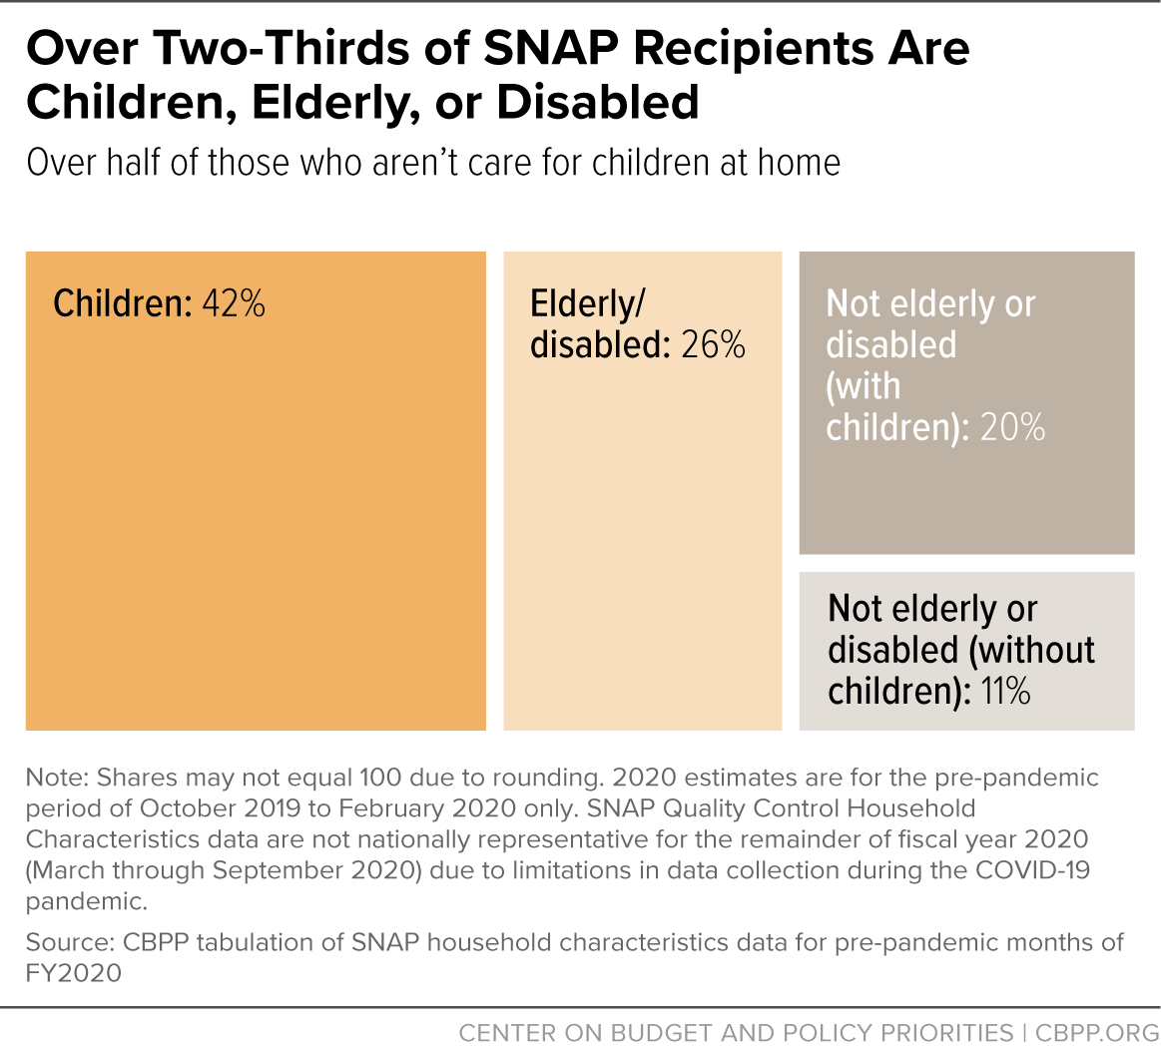
Unprecedented Cuts to Food Assistance
More than 41 million people including children, parents, seniors, and veterans at risk of losing food benefits.
Largest cut to SNAP in history (about 20%)
Shifts share of benefit costs (5-15% for most states) to states for first time, starting in 2028
States that can’t or won’t pay cost shift would see SNAP program end
Shifts additional administrative costs to states
Significant expansion of SNAP's already harsh, ineffective, and red-tape laden work requirements
Takes food benefits away from many lawfully present immigrants
SNAP benefits won’t keep pace with cost of healthy diet
Notes:
Now, turning to SNAP – here are the main things to know.
Unprecendent cuts to food benefits could result in higher grocery costs for as many as Raises the cost of groceries for up to 144,000 Rhode Islanders
Requires most states for the first time to pay between 5 to 15 percent of SNAP food benefit costs, If [state] lawmakers can’t meet this unfunded mandate, they would have to either reduce the state’s costs by cutting the number of people who get SNAP, or opt out of SNAP entirely, which would leave Rhode Islanders without the food assistance they need to buy groceries and would negatively impact grocers, especially in rural communities.
10,000 Rhode Islanders would be at risk of losing some of their food assistance, including many children, under a significant expansion of SNAP’s already harsh, ineffective, and red tape-laden work requirements to parents and other caretakers of children aged 14 and up and adults aged 55 to 64. In addition, RI would only be able to waive the work requirement in areas where the unemployment rate exceeds 10 percent, even during a recession when unemployment rises significantly but does not meet this extremely high level. The new law also eliminates the current exemption to the work requirement for veterans, people experiencing homelessness, and youth who recently aged out of foster care.
Takes away food assistance from people who have been granted humanitarian protections, including refugees, people granted asylum, and certain victims of domestic violence or sex or labor trafficking, among others living lawfully in the U.S. In 2023 there were roughly 1,000 participating in SNAP who were admitted as refugees, granted asylum, or granted withholding of removal.

Slide 6
Key SNAP Effective Dates
Underway Now
Expanding SNAP’s work requirement to include adults with children 14 and older, older adults 55-64, veterans, people experiencing homelessness, and young people who recently aged out of foster care.
November 2025
Administration terminates previously approved waivers from SNAP’s work requirement for areas with elevated unemployment. Individuals newly subject to the work requirement will begin losing SNAP in March 2026.
October 2026
Cuts future SNAP benefits by restricting updates to the Thrifty Food Plan to account only for food inflation.​ Also requires states to pay 75% of SNAP administrative costs instead of 50%.​
October 2027
Most states must pay 5% to 15% of SNAP food benefit costs, based on either the 2025 or 2026 error rate at the option of the state. ​​

Slide 7
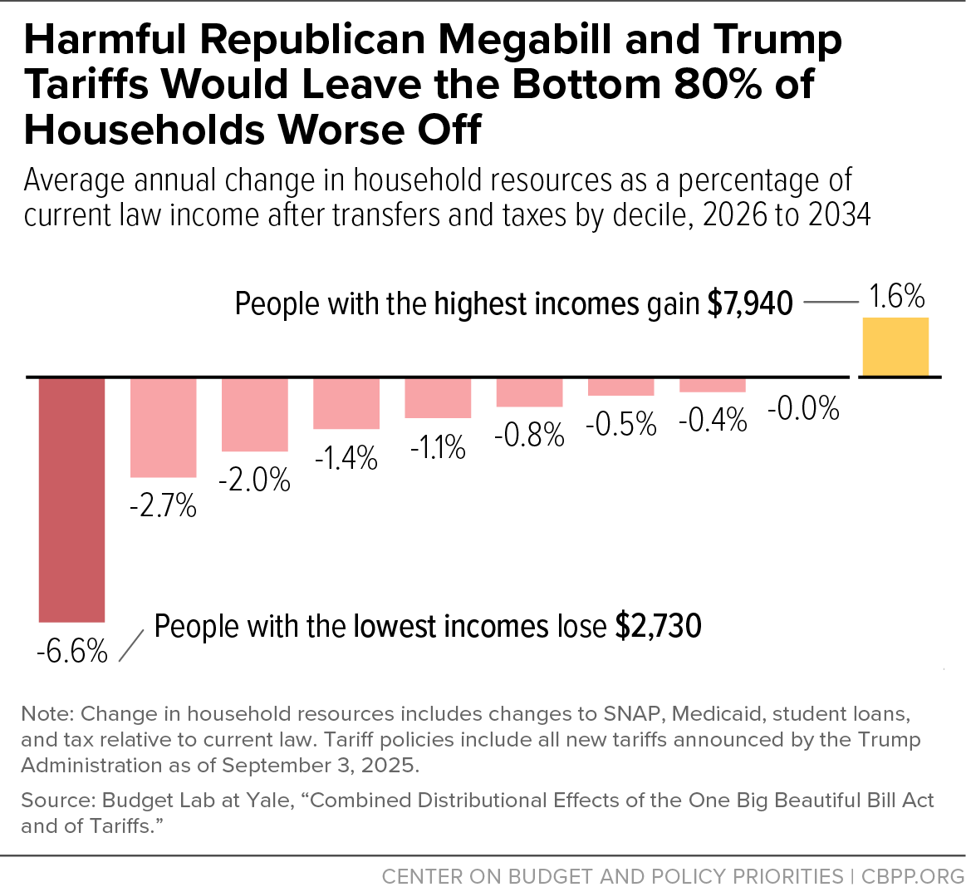
Unprecedented Combination: Tax Cuts for Wealthy & Harm for Others
All tax cuts for wealthy extended plus additional tax-free inheritances for wealthiest & new corporate tax cuts
So-called “middle class” improvements (like no tax on tips) are modest and time-limited
One tax cut not extended: enhanced premium tax cuts
Large cuts that take away health care and food assistance away from low- & moderate-income people
17 million children in low-income families get no help from Child Tax Credit expansion
90% of households will be worse off under the combination of the reconciliation bill and the President’s tariffs, which hit low- and middle-income consumers particularly hard

Slide 8
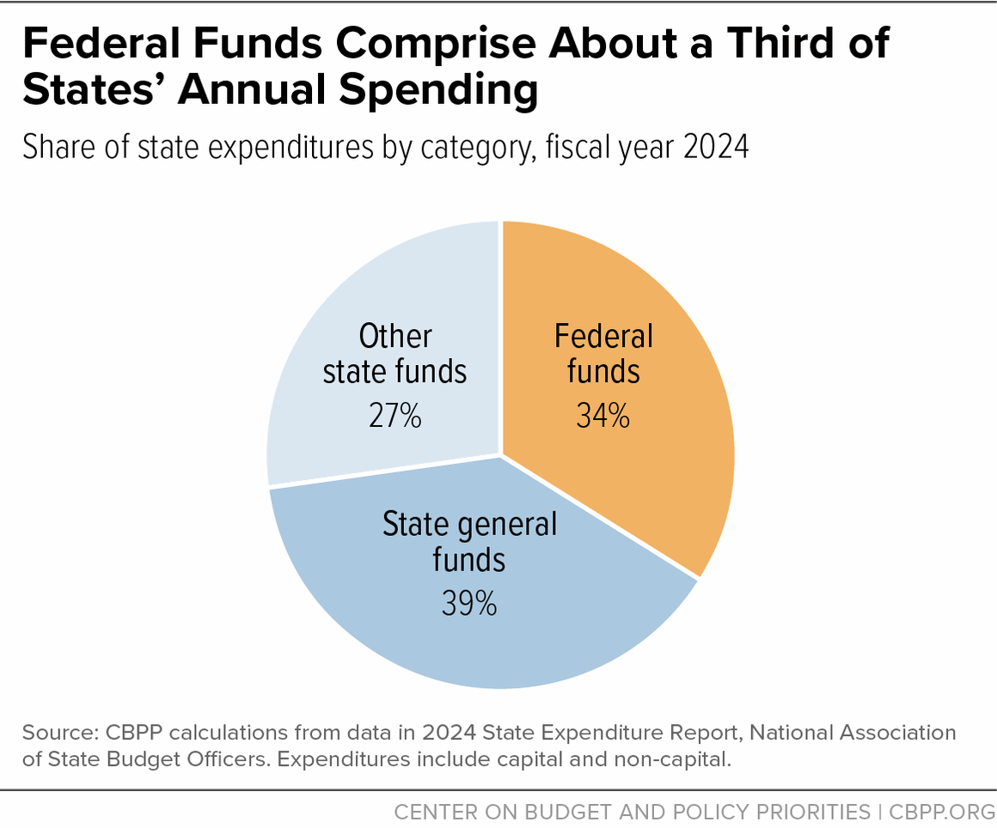
Federal Cuts Pose Major New Challenges for States
About one-third of state funds currently come from the federal government
Reconciliation bill includes massive cuts and additional costs to states, shifting responsibility or reducing flexibility
State revenues also at risk due to complex linkages between state and federal tax codes, known as “conformity”
Passes the buck to state and local lawmakers who are forced to make painful tradeoffs.
Notes:
This is going to be a big deal for states and in some way localities, for the next several years to come.
For one, federal funds simply account for a major share of state budgets overall – about 1 out of every 3 dollar available in state budgets nationwide –
and the R megabill both makes significant cuts in that category (most especially through Medicaid) as well as adds some additional costs for states (most especially through the SNAP food assistance program).
It’s also true – that while not a core focus here today – that the big federal tax changes are also slated to have some direct impact on state revenues, due to various ways in which state and federal income tax codes are linked together.

Slide 9
States Have Some Flexibility to Reduce Negative Impacts from HR 1
For example, for the new Medicaid work requirements, states can:
Elect policy options in the law that reduce new burdens, such as requiring applicants to be compliant or exempt for only one month before their month of application and verifying compliance for enrollees only when they renew coverage, rather than more frequently.
Maximize data sources to automatically verify exemptions and compliance, including coordination with SNAP to identify individuals who are eligible for an exemption from the Medicaid work requirement.
Deploy user-friendly pathways for individuals to report compliance activities and exemptions, such as ensuring simple and accessible document submission.
Details outlined in new CBPP report.

Slide 10
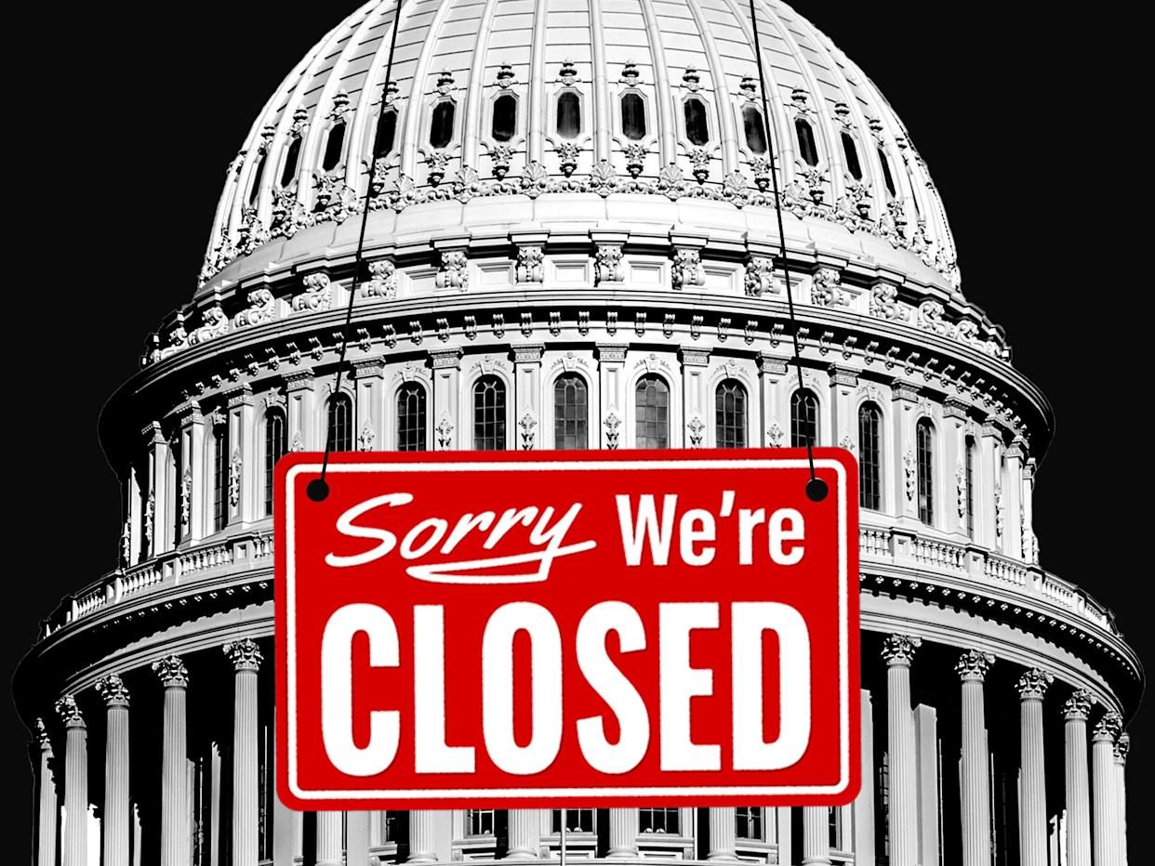
Government Shutdown Adding to the Pain
The Trump Administration refused for weeks to provide any SNAP food assistance benefits for the month of November during the shutdown.
Per a recent court order, partial payments will now be made on a delayed basis in November using SNAP contingency funds.
Additional funds could be added to the contingency reserves to make complete SNAP payments in November, but the Trump Administration has not committed to take that step.

Slide 11
Conclusion:
HR 1 includes enormous cuts in assistance for needy people and significant cost-shifts for states to partially pay for tax cuts primarily focused on wealthy households, but states do have limited flexibility to mitigate some of the harm.

